Slide 1


SMART INDIA HACKATHON 2025
TITLE PAGE
Problem Statement ID – SIH25040
Problem Statement Title- FloatChat- AI-Powered Conversational Interface for ARGO Ocean Data Discovery and Visualization
Theme- Miscellaneous
PS Category- Software
Team ID-
Team Name (Registered on portal)

Slide 2



IDEA TITLE
Your Team Name
IDEA /SOLUTION
PROBLEM RESOLUTION
An AI-powered Conversational Interface (FloatChat) for intuitive discovery and visualization of global ARGO data.
♦ Natural Language Processing (NLP) engine to instantly understand complex user queries.
♦ Interactive, on-demand visualizations generated directly within the chat interface.
♦ Machine Learning models for predictive analytics, trend identification, and anomaly detection.
♦ Seamless integration with global ARGO data repositories for real-time data access.
♦ Designed for maximum accessibility, requiring no specialized coding skills.
♦ Simplifies complex data access, removing the need for intricate scripts or database navigation.
♦ Accelerates data discovery, drastically reducing the time from question to visual insight.
♦ Addresses data overload by conversationally pinpointing key information in massive datasets.
UNIQUE VALUE PROPOSITIONS (UVP)
♦ Instant Visualizations from simple conversational queries.
♦ AI-Driven Insights that automatically identify key trends and anomalies.
♦ Universally Accessible & Scalable, with the latest up-to-date global ocean data.

Slide 3

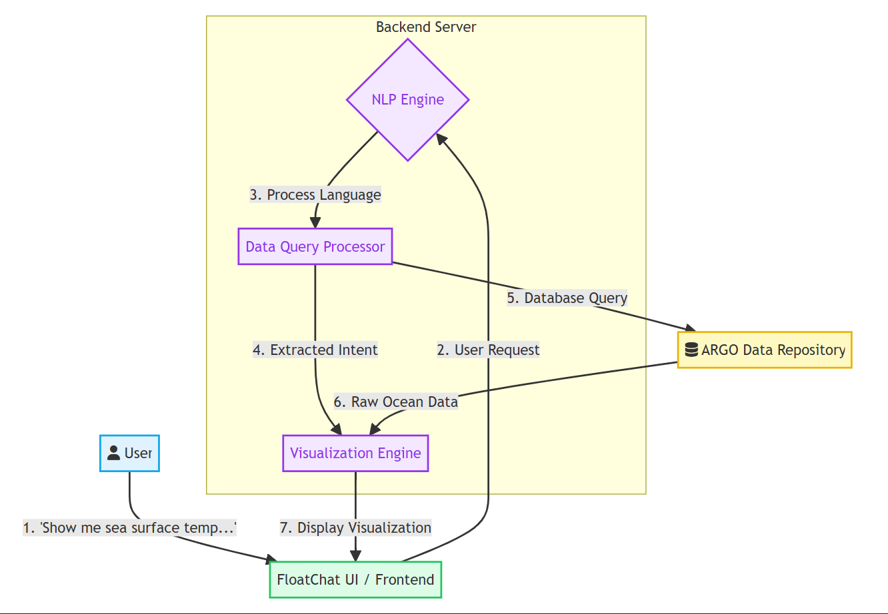

TECHNICAL APPROACH
Your Team Name
TECHNICAL STACK
♦ Frontend:
Three.js (React) - For building the fast and modern conversational UI.
♦ Backend:
Python & FastAPI - For high-performance APIs and core data processing logic.
♦ AI & Data Processing:
spaCy & Transformers for NLP; Pandas for data manipulation.
♦ Data Visualization:
Plotly.js & D3.js - To generate interactive, real-time charts and maps.
♦ Database & Cloud:
PostgreSQL with Docker on AWS/GCP for a scalable cloud deployment.
PRODUCT STATUS

Slide 4


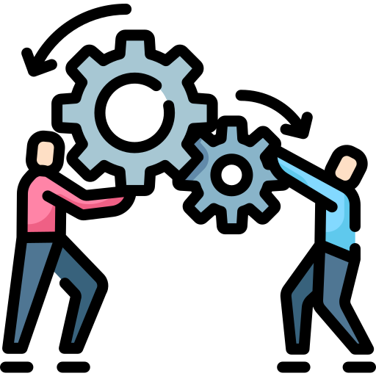

FEASIBILITY AND VIABILITY
Your Team Name
TECHNICAL FEASIBILITY
AI analysis using open-source NLP models. ARGO data is accessible via reliable public APIs. Modern web frameworks ensure a responsive and scalable platform.
OPERATIONAL FEASIBILITY
Easy adoption by researchers, students, and policymakers. Works for non-coders and specialists alike through an intuitive conversational UI.
ECONOMICAL FEASIBILITY Uses open-source frameworks making it cost-effective. Free-tier cloud services reduce expenses compared to expensive proprietary software.
CHALLENGES & SOLUTIONS
Performance Lag: Implement intelligent caching and data indexing to pre-process common queries for instant results. | NLP Accuracy: Fine-tune language models on scientific literature to better understand domain-specific queries. | Scalability: Adopt a cloud-native, serverless architecture to handle increasing user loads efficiently.
Performance Lag: Use optimized data aggregation techniques on the backend to minimize the load of real-time computations. | User Adoption: Design a highly intuitive UX that is superior to existing tools. Engage a pilot user group for feedback. | Scalability: Employ a microservices architecture to allow independent and efficient scaling of system components.

Slide 5



IMPACT AND BENEFITS
Your Team Name
POTENTIAL IMPACT
PROTOTYPE
♦ Faster Scientific Discovery: Researchers can analyze complex ocean data in minutes.
♦ Improved Climate Modeling: Quicker, easier access to essential climate change data.
♦ Democratized Data Access: Students & public can explore vital ocean data easily.
BENEFITS
♦ Social: Enhances climate education; supports data-driven environmental policies.
♦ Economic: Reduces software costs for institutions; optimizes researchers' time.
♦ Environmental: Promotes better ocean monitoring; aids marine conservation efforts.

Slide 6
RESEARCH AND REFERENCES
Your Team Name
Details / Links of the reference and research work

